Slide 1
Module 4: Classification Part 2 TMA4268 Statistical Learning V2023
Daesoo Lee,
Department of Mathematical Sciences, NTNU
01/02/2023

Slide 2
Recap

Slide 3
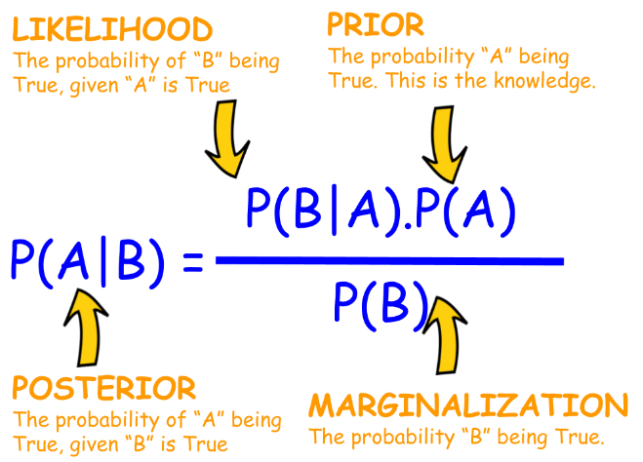
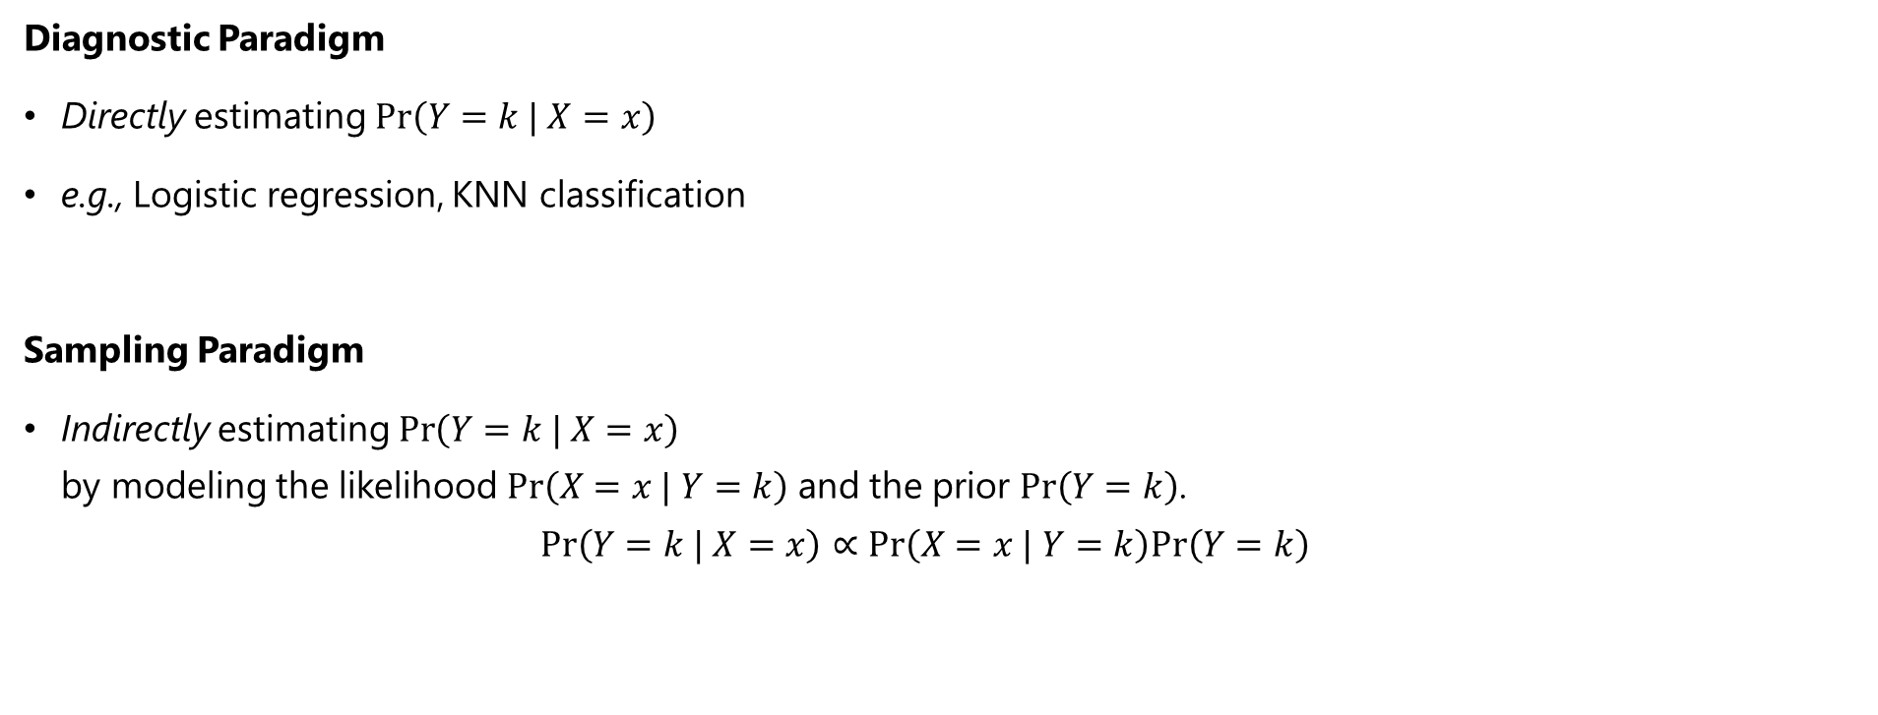
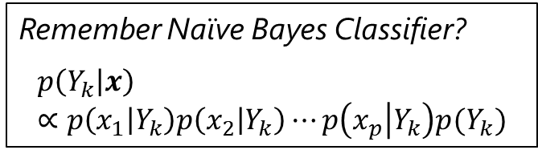
Recap
Two approaches to estimate $Pr\left(Y=k | X=x\right)$
Diagnostic Paradigm
Directly estimating $Pr\left(Y=k | X=x\right)$
e.g., Logistic regression, KNN classification
Sampling Paradigm
Indirectly estimating $Pr\left(Y=k | X=x\right)$ by modeling the likelihood $Pr\left(X=x | Y=k\right)$ and the prior $Pr\left(Y=k\right)$. $Pr\left(Y=k | X=x\right)∝Pr\left(X=x | Y=k\right)Pr\left(Y=k\right)$
Bayes Theorem
Remember Naïve Bayes Classifier?
$$p\left(Y_{k} | x\right) ∝p\left(x_{1} | Y_{k}\right)p\left(x_{2} | Y_{k}\right)⋯p\left(x_{p} | Y_{k}\right)p(Y_{k})$$

Slide 4
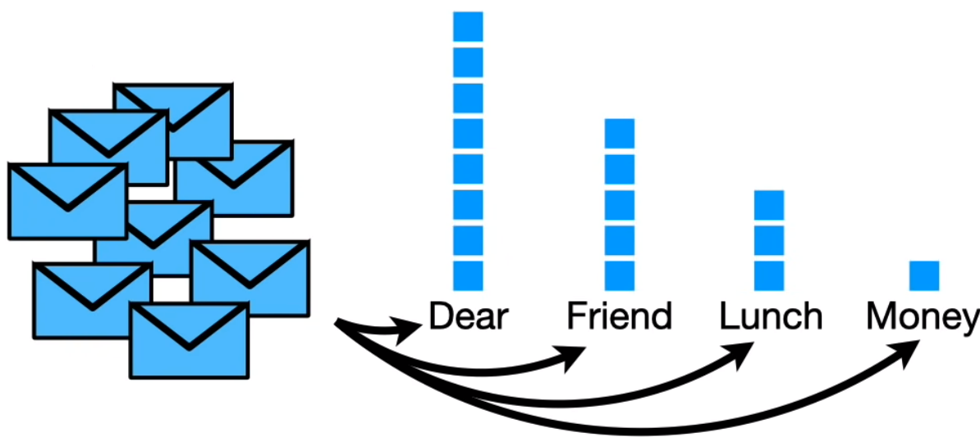
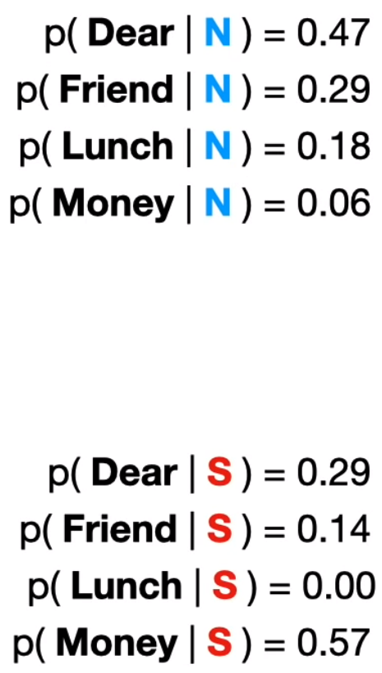
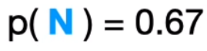
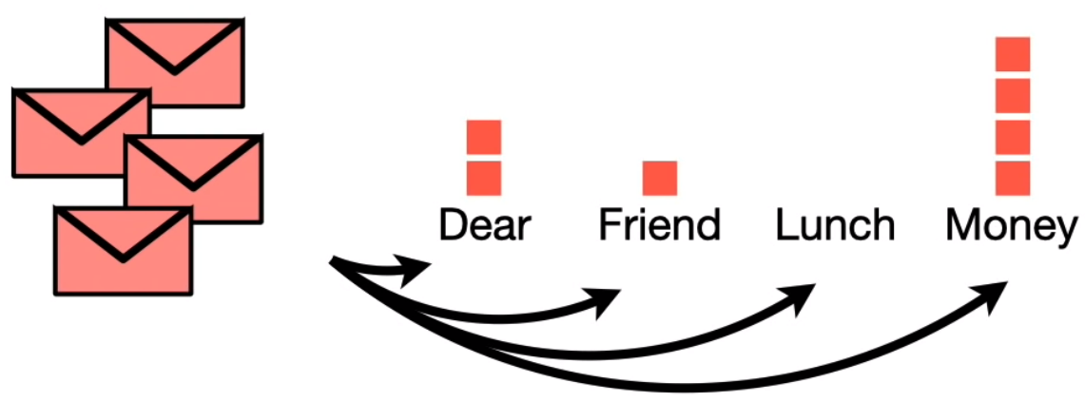
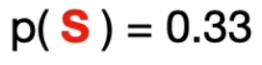
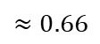
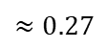
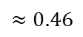
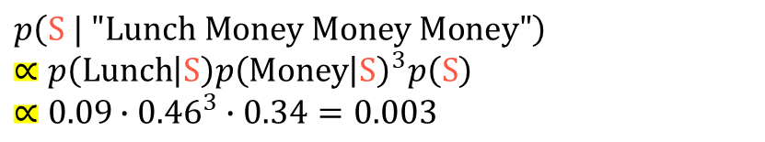
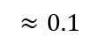
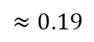
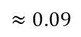
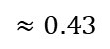
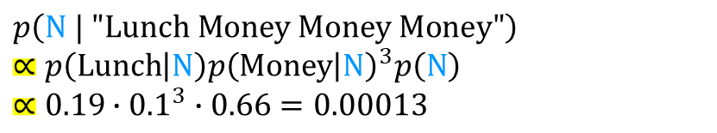
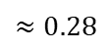
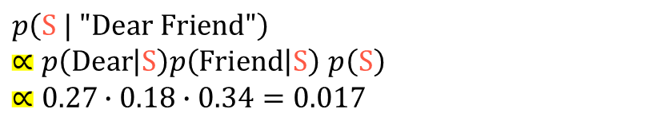
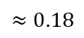
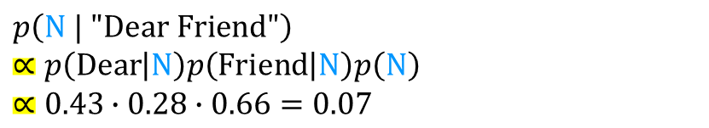
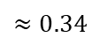
The Bayes classifier
$$p\left(Y_{k} | x\right) ∝p\left(x_{1} | Y_{k}\right)p\left(x_{2} | Y_{k}\right)⋯p\left(x_{p} | Y_{k}\right)p(Y_{k})$$
Example: Naïve Bayes Classifier
Email: “Dear Friend”
9
Normal
$$p\left(N | "Dear Friend"\right) \\ ∝p\left(Dear | N\right)p\left(Friend | N\right)p\left(N\right) \\ ∝0.43∙0.28∙0.66=0.07$$
6
$$≈0.43$$
4
$$≈0.28$$
2
$$≈0.19$$
$$≈0.1$$
$$p\left(S | "Dear Friend"\right)$$ $∝p\left(Dear | S\right)p\left(Friend | S\right)$ $p\left(S\right)$ $$∝0.27∙0.18∙0.34=0.017$$
$$≈0.66$$
5
3
$$≈0.27$$
2
Email: “Lunch Money Money Money”
1
$$≈0.18$$
$$≈0.09$$
$$p\left(N | "Lunch Money Money Money"\right) \\ ∝p\left(Lunch | N\right)p{\left(Money | N\right)}^{3}p\left(N\right) \\ ∝0.19∙{0.1}^{3}∙0.66=0.00013$$
$$≈0.46$$
SPAM
$$≈0.34$$
$$p\left(S | "Lunch Money Money Money"\right) \\ ∝p\left(Lunch | S\right)p{\left(Money | S\right)}^{3}p\left(S\right) \\ ∝0.09∙{0.46}^{3}∙0.34=0.003$$
Total num of emails = 32
https://youtu.be/O2L2Uv9pdDA

Slide 5
Discriminant Analysis High-Level Concept

Slide 6
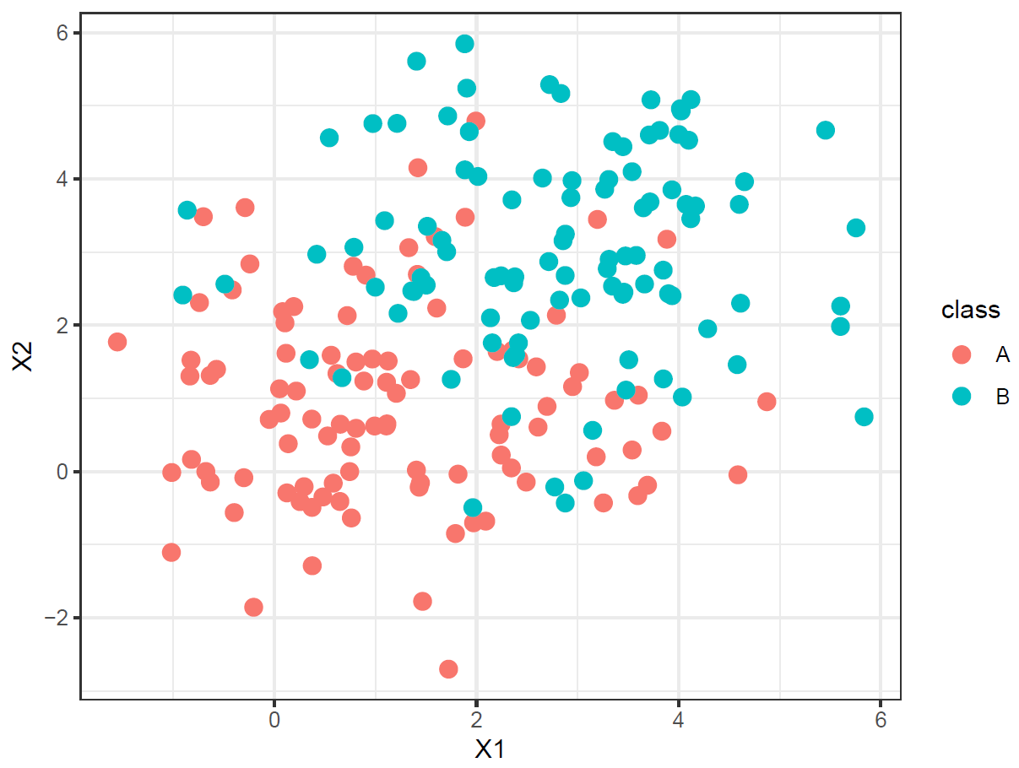

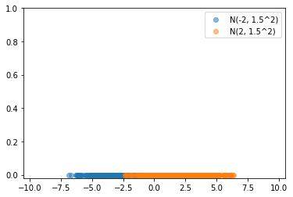
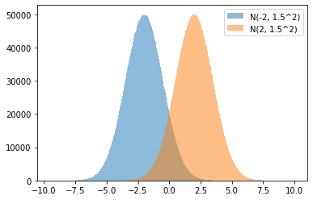
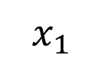


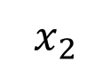
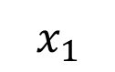
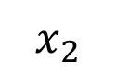
Discriminant Analysis: High-Level Concept
What’s the Discriminant Analysis method?
$$x_{2}$$
$$x_{1}$$
Decision boundary
$$x_{2}$$
$$x_{1}$$

Slide 7
Discriminant Analysis

Slide 8

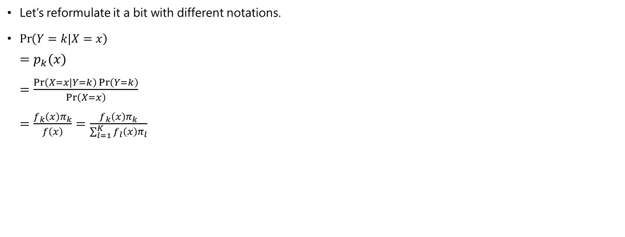
Discriminant Analysis
Bayes Theorem
Let’s reformulate it a bit with different notations.
$\operatorname{Pr}\left(Y=k|X=x\right)$ $=p_{k}(x)$ $=\frac{\operatorname{Pr}\left(X=x|Y=k\right)\operatorname{Pr}\left(Y=k\right)}{\operatorname{Pr}\left(X=x\right)}$ $=\frac{f_{k}\left(x\right)π_{k}}{f\left(x\right)}=\frac{f_{k}\left(x\right)π_{k}}{\sum_{l=1}^{K}{f_{l}\left(x\right)}π_{l}}$

Slide 9
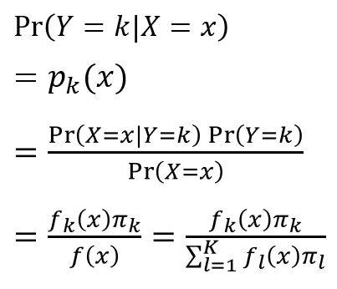

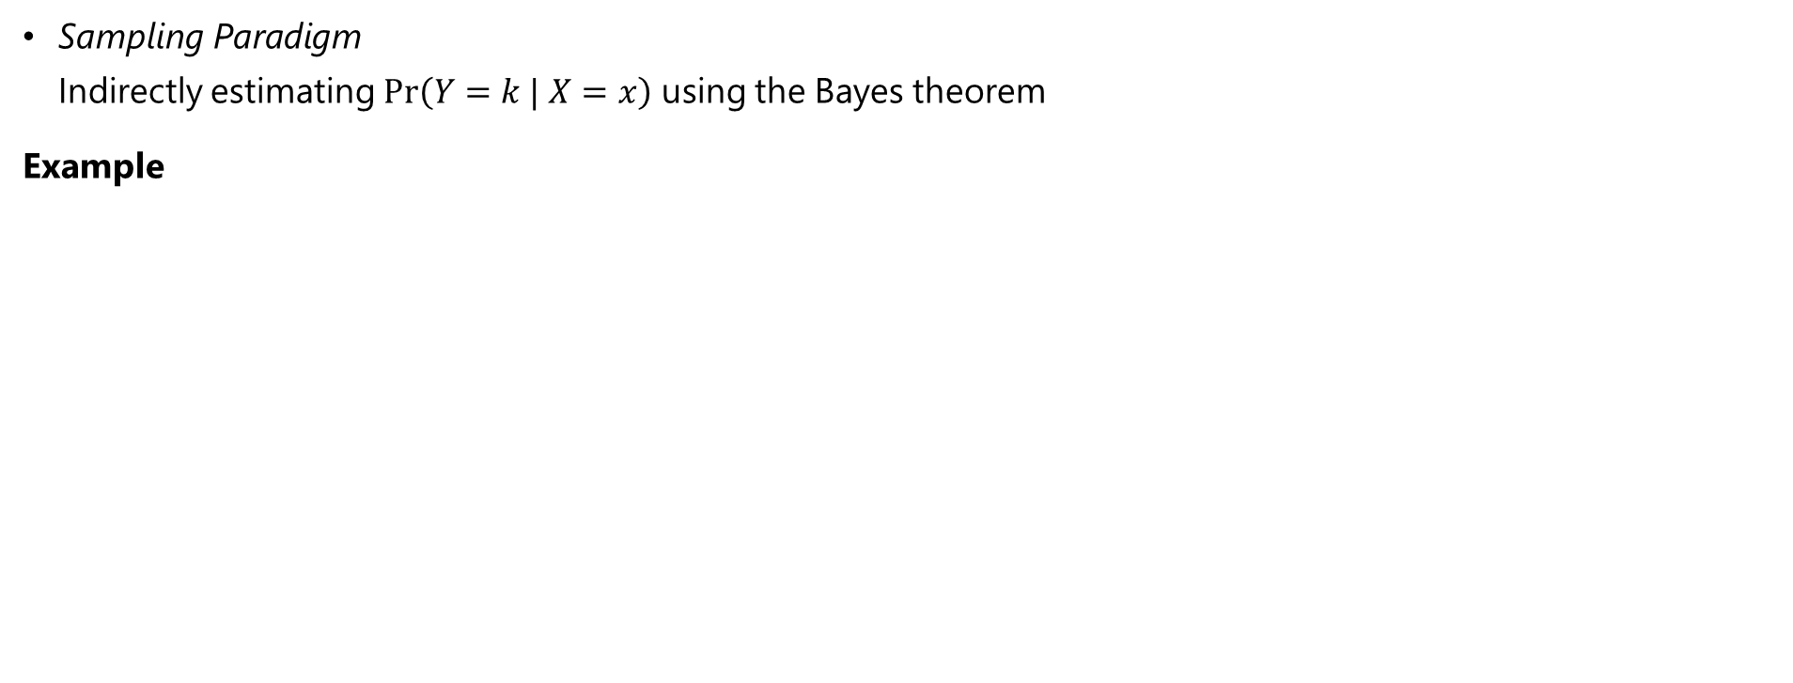
Discriminant Analysis
Discriminant Analysis belongs to Sampling Paradigm
Sampling Paradigm Indirectly estimating $Pr\left(Y=k | X=x\right)$ using the Bayes theorem
Example
Blue is modeled by $N\left(−{2, 1.5}^{2}\right)$
Orange is modeled by $N\left({2, 1.5}^{2}\right)$

Slide 10


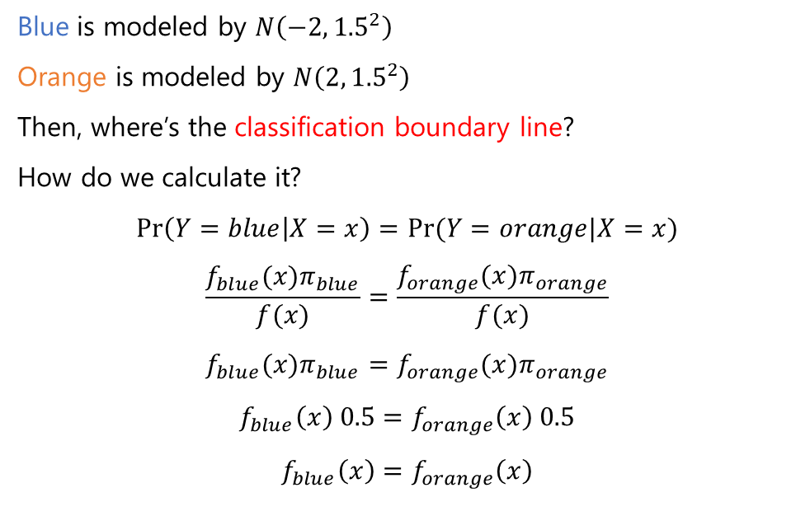
Discriminant Analysis
Discriminant Analysis belongs to Sampling Paradigm
Sampling Paradigm Indirectly estimating $Pr\left(Y=k | X=x\right)$ using the Bayes theorem
Example
Blue is modeled by $N\left(−{2, 1.5}^{2}\right)$
Orange is modeled by $N\left({2, 1.5}^{2}\right)$
Then, where’s the classification boundary line?
How do we calculate it?
$$\operatorname{Pr}\left(Y=blue | X=x\right)=Pr⁡(Y=orange|X=x)$$
$$\frac{f_{blue}(x)π_{blue}}{f(x)}=\frac{f_{orange}(x)π_{orange}}{f(x)}$$
$$f_{blue}(x)π_{blue}=f_{orange}(x)π_{orange}$$
$$f_{blue}\left(x\right) 0.5=f_{orange}\left(x\right) 0.5$$
$$f_{blue}\left(x\right)=f_{orange}\left(x\right)$$
count
10,000,000 samples
10,000,000 samples

Slide 11
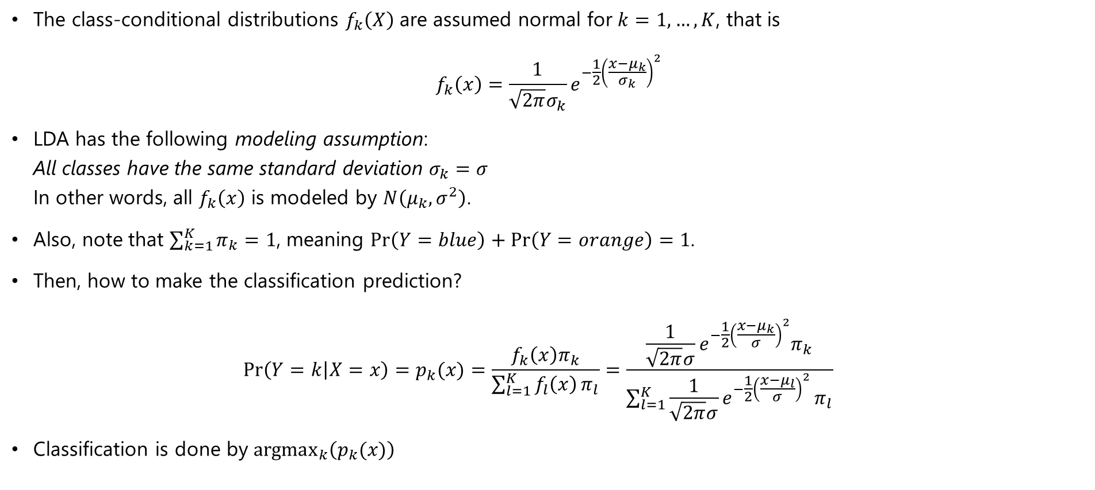
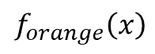
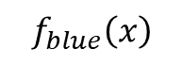
Discriminant Analysis - LDA
Linear discriminant analysis (LDA) when $p=1$
The class-conditional distributions $f_{k}\left(X\right)$ are assumed normal for $k=1,…,K$, that is
$$f_{k}\left(x\right)=\frac{1}{\sqrt{2π}σ_{k}}e^{−\frac{1}{2}{\left(\frac{x−μ_{k}}{σ_{k}}\right)}^{2}}$$
LDA has the following modeling assumption: All classes have the same standard deviation $σ_{k}=σ$ In other words, all $f_{k}\left(x\right)$ is modeled by $N\left(μ_{k},σ^{2}\right)$.
Also, note that $\sum_{k=1}^{K}{π_{k}}=1$, meaning $\operatorname{Pr}\left(Y=blue\right)+\operatorname{Pr}\left(Y=orange\right)=1$.
Then, how to make the classification prediction? $\operatorname{Pr}\left(Y=k | X=x\right)=p_{k}(x)=\frac{f_{k}\left(x\right)π_{k}}{\sum_{l=1}^{K}{f_{l}\left(x\right)}π_{l}}=\frac{\frac{1}{\sqrt{2π}σ}e^{−\frac{1}{2}{\left(\frac{x−μ_{k}}{σ}\right)}^{2}}π_{k}}{\sum_{l=1}^{K}{\frac{1}{\sqrt{2π}σ}e^{−\frac{1}{2}{\left(\frac{x−μ_{l}}{σ}\right)}^{2}}}π_{l}}$
Classification is done by ${argmax}_{k}\left(p_{k}(x)\right)$
$$f_{blue}\left(x\right)$$
$$f_{orange}\left(x\right)$$

Slide 12
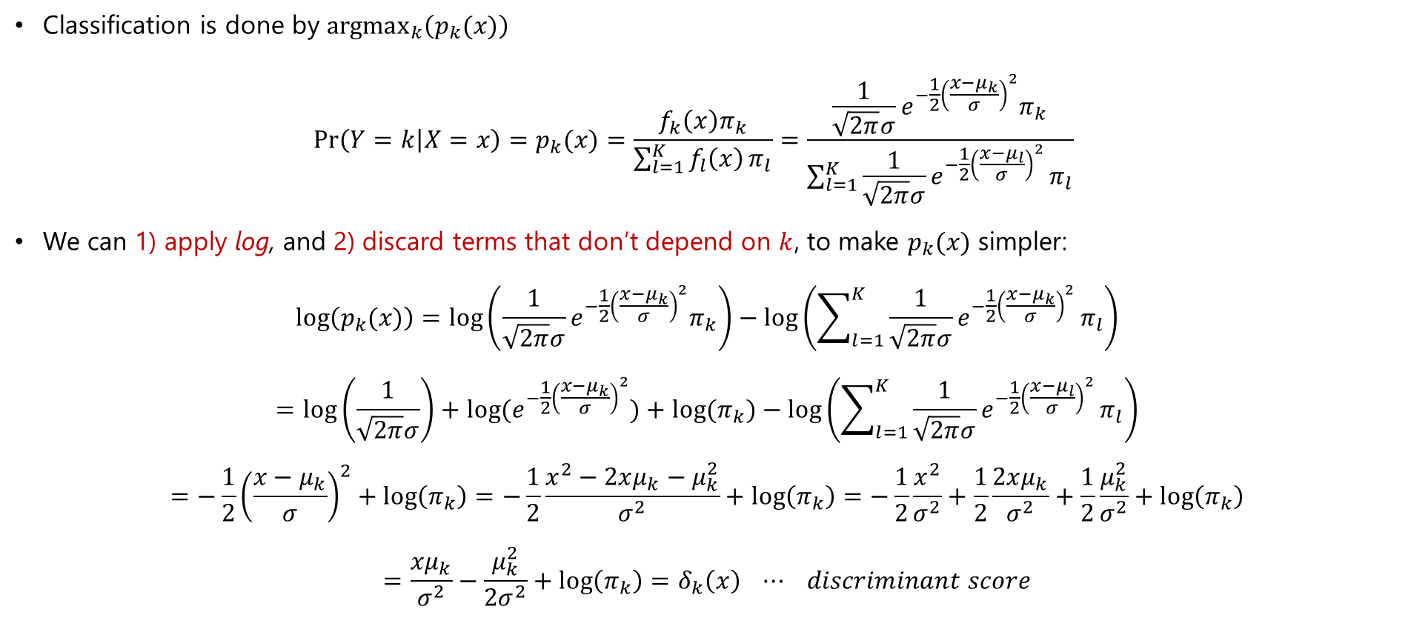



Discriminant Analysis - LDA
Linear discriminant analysis (LDA) when $p=1$
Classification is done by ${argmax}_{k}\left(p_{k}(x)\right)$ $\operatorname{Pr}\left(Y=k | X=x\right)=p_{k}(x)=\frac{f_{k}\left(x\right)π_{k}}{\sum_{l=1}^{K}{f_{l}\left(x\right)}π_{l}}=\frac{\frac{1}{\sqrt{2π}σ}e^{−\frac{1}{2}{\left(\frac{x−μ_{k}}{σ}\right)}^{2}}π_{k}}{\sum_{l=1}^{K}{\frac{1}{\sqrt{2π}σ}e^{−\frac{1}{2}{\left(\frac{x−μ_{l}}{σ}\right)}^{2}}}π_{l}}$
We can 1) apply log, and 2) discard terms that don’t depend on $k$, to make $p_{k}(x)$ simpler:
$$\log\left(p_{k}(x)\right)=\log\left(\frac{1}{\sqrt{2π}σ}e^{−\frac{1}{2}{\left(\frac{x−μ_{k}}{σ}\right)}^{2}}π_{k}\right)−\log\left(\sum_{l=1}^{K}{\frac{1}{\sqrt{2π}σ}e^{−\frac{1}{2}{\left(\frac{x−μ_{k}}{σ}\right)}^{2}}}π_{l}\right)$$
$$=\log\left(\frac{1}{\sqrt{2π}σ}\right)+log⁡(e^{−\frac{1}{2}{\left(\frac{x−μ_{k}}{σ}\right)}^{2}})+log⁡(π_{k})−\log\left(\sum_{l=1}^{K}{\frac{1}{\sqrt{2π}σ}e^{−\frac{1}{2}{\left(\frac{x−μ_{l}}{σ}\right)}^{2}}}π_{l}\right)$$
$$=−\frac{1}{2}{\left(\frac{x−μ_{k}}{σ}\right)}^{2}+\log\left(π_{k}\right)=−\frac{1}{2}\frac{x^{2}−2xμ_{k}−μ_{k}^{2}}{σ^{2}}+\log\left(π_{k}\right)=−\frac{1}{2}\frac{x^{2}}{σ^{2}}+\frac{1}{2}\frac{2xμ_{k}}{σ^{2}}+\frac{1}{2}\frac{μ_{k}^{2}}{σ^{2}}+\log\left(π_{k}\right)$$
$$=\frac{xμ_{k}}{σ^{2}}−\frac{μ_{k}^{2}}{{2σ}^{2}}+\log\left(π_{k}\right)=δ_{k}\left(x\right) ⋯ discriminant score$$

Slide 13
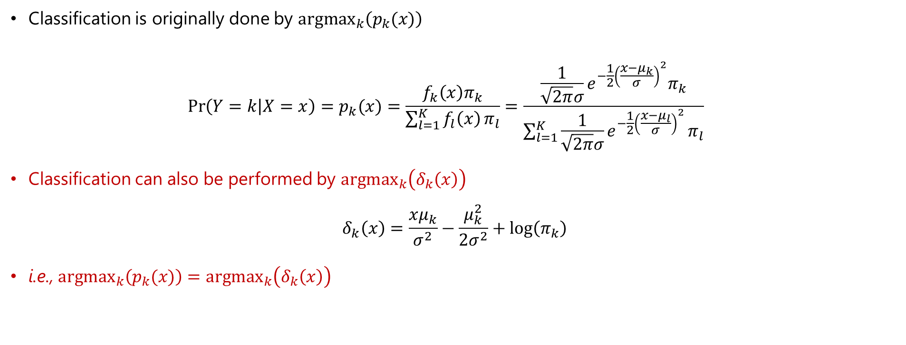
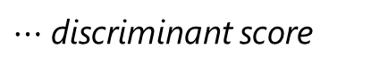
Discriminant Analysis - LDA
Linear discriminant analysis (LDA) when $p=1$
Classification is originally done by ${argmax}_{k}\left(p_{k}(x)\right)$ $\operatorname{Pr}\left(Y=k | X=x\right)=p_{k}(x)=\frac{f_{k}\left(x\right)π_{k}}{\sum_{l=1}^{K}{f_{l}\left(x\right)}π_{l}}=\frac{\frac{1}{\sqrt{2π}σ}e^{−\frac{1}{2}{\left(\frac{x−μ_{k}}{σ}\right)}^{2}}π_{k}}{\sum_{l=1}^{K}{\frac{1}{\sqrt{2π}σ}e^{−\frac{1}{2}{\left(\frac{x−μ_{l}}{σ}\right)}^{2}}}π_{l}}$
Classification can also be performed by ${argmax}_{k}\left(δ_{k}\left(x\right)\right)$
$$δ_{k}\left(x\right)=\frac{xμ_{k}}{σ^{2}}−\frac{μ_{k}^{2}}{{2σ}^{2}}+\log\left(π_{k}\right)$$
i.e., ${argmax}_{k}\left(p_{k}(x)\right)={argmax}_{k}\left(δ_{k}\left(x\right)\right)$
$⋯$ discriminant score

Slide 14
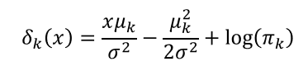
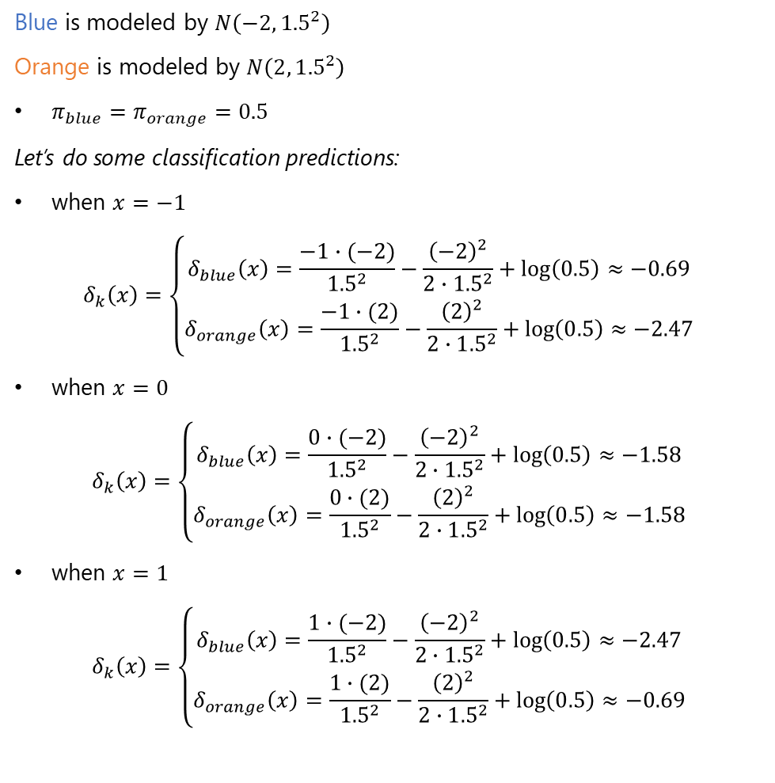
Discriminant Analysis - LDA
Blue is modeled by $N\left(−{2, 1.5}^{2}\right)$
Orange is modeled by $N\left({2, 1.5}^{2}\right)$
$π_{blue}=π_{orange}=0.5$
Let’s do some classification predictions:
when $x=−1$
$$δ_{k}\left(x\right)=\left\{\begin{aligned}δ_{blue}\left(x\right)=\frac{−1∙(−2)}{{1.5}^{2}}−\frac{{\left(−2\right)}^{2}}{{2∙1.5}^{2}}+\log\left(0.5\right)≈−0.69 \\ δ_{orange}\left(x\right)=\frac{−1∙(2)}{{1.5}^{2}}−\frac{{\left(2\right)}^{2}}{{2∙1.5}^{2}}+\log\left(0.5\right)≈−2.47\end{aligned}\right.$$
when $x=0$
$$δ_{k}\left(x\right)=\left\{\begin{aligned}δ_{blue}\left(x\right)=\frac{0∙(−2)}{{1.5}^{2}}−\frac{{\left(−2\right)}^{2}}{{2∙1.5}^{2}}+\log\left(0.5\right)≈−1.58 \\ δ_{orange}\left(x\right)=\frac{0∙(2)}{{1.5}^{2}}−\frac{{\left(2\right)}^{2}}{{2∙1.5}^{2}}+\log\left(0.5\right)≈−1.58\end{aligned}\right.$$
when $x=1$
$$δ_{k}\left(x\right)=\left\{\begin{aligned}δ_{blue}\left(x\right)=\frac{1∙(−2)}{{1.5}^{2}}−\frac{{\left(−2\right)}^{2}}{{2∙1.5}^{2}}+\log\left(0.5\right)≈−2.47 \\ δ_{orange}\left(x\right)=\frac{1∙(2)}{{1.5}^{2}}−\frac{{\left(2\right)}^{2}}{{2∙1.5}^{2}}+\log\left(0.5\right)≈−0.69\end{aligned}\right.$$
Back to Example
count
10,000,000 samples
10,000,000 samples

Slide 15
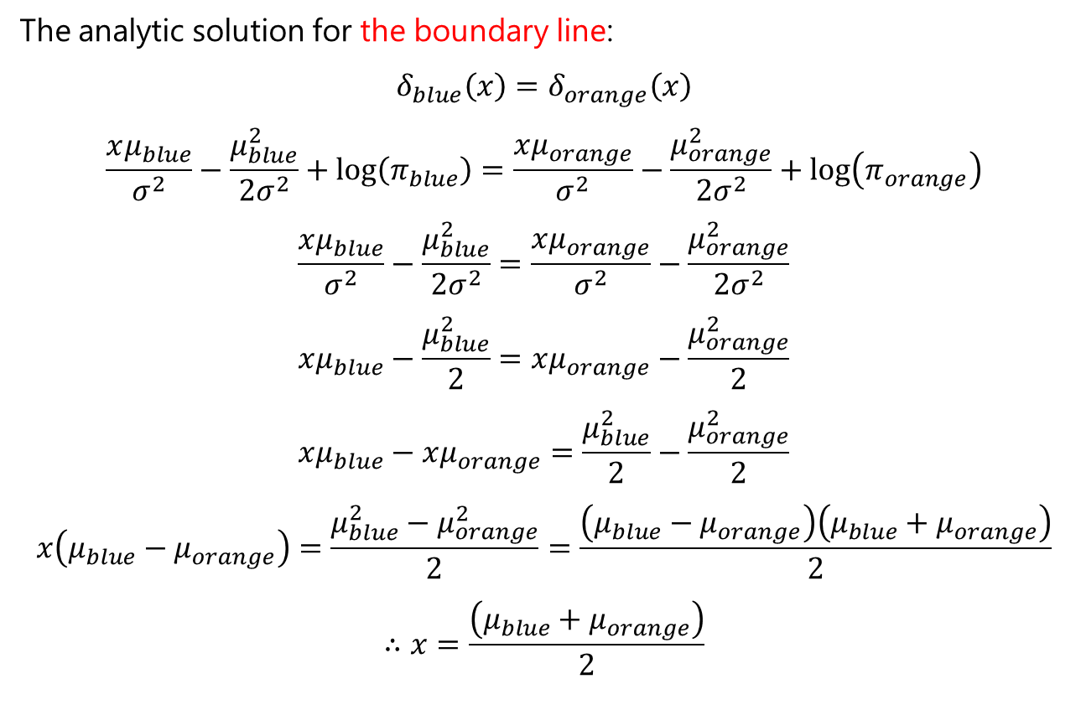
Discriminant Analysis - LDA
Back to Example
The analytic solution for the boundary line:
$$δ_{blue}\left(x\right)=δ_{orange}\left(x\right)$$
$$\frac{xμ_{blue}}{σ^{2}}−\frac{μ_{blue}^{2}}{{2σ}^{2}}+\log\left(π_{blue}\right)=\frac{xμ_{orange}}{σ^{2}}−\frac{μ_{orange}^{2}}{{2σ}^{2}}+\log\left(π_{orange}\right)$$
$$\frac{xμ_{blue}}{σ^{2}}−\frac{μ_{blue}^{2}}{{2σ}^{2}}=\frac{xμ_{orange}}{σ^{2}}−\frac{μ_{orange}^{2}}{{2σ}^{2}}$$
$$xμ_{blue}−\frac{μ_{blue}^{2}}{2}=xμ_{orange}−\frac{μ_{orange}^{2}}{2}$$
$$xμ_{blue}−xμ_{orange}=\frac{μ_{blue}^{2}}{2}−\frac{μ_{orange}^{2}}{2}$$
$$x\left(μ_{blue}−μ_{orange}\right)=\frac{μ_{blue}^{2}−μ_{orange}^{2}}{2}=\frac{\left(μ_{blue}−μ_{orange}\right)\left(μ_{blue}+μ_{orange}\right)}{2}$$
$$∴x=\frac{\left(μ_{blue}+μ_{orange}\right)}{2}$$
count
10,000,000 samples
10,000,000 samples

Slide 16
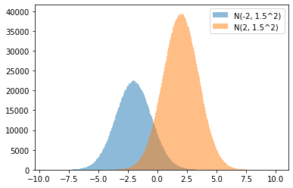
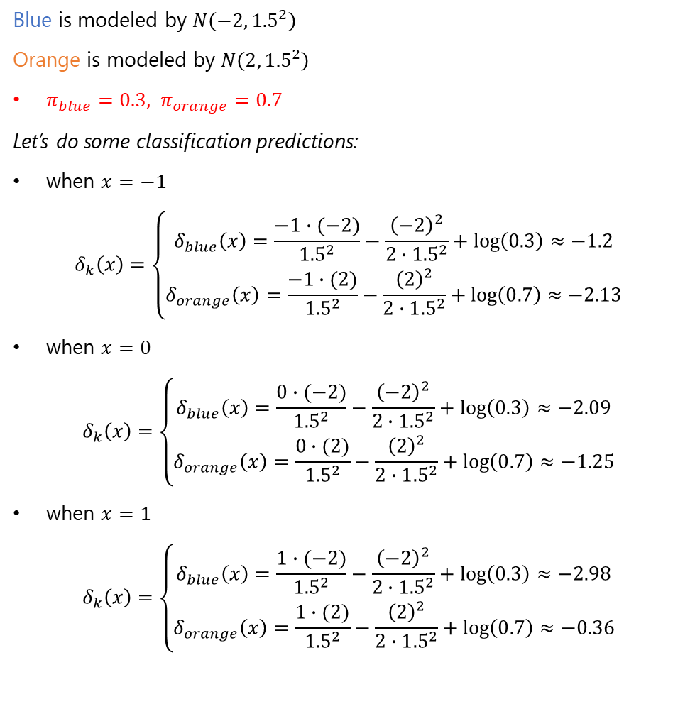
Discriminant Analysis - LDA
Blue is modeled by $N\left(−{2, 1.5}^{2}\right)$
Orange is modeled by $N\left({2, 1.5}^{2}\right)$
$π_{blue}=0.3, π_{orange}=0.7$
Let’s do some classification predictions:
when $x=−1$
$$δ_{k}\left(x\right)=\left\{\begin{aligned}δ_{blue}\left(x\right)=\frac{−1∙(−2)}{{1.5}^{2}}−\frac{{\left(−2\right)}^{2}}{{2∙1.5}^{2}}+\log\left(0.3\right)≈−1.2 \\ δ_{orange}\left(x\right)=\frac{−1∙(2)}{{1.5}^{2}}−\frac{{\left(2\right)}^{2}}{{2∙1.5}^{2}}+\log\left(0.7\right)≈−2.13\end{aligned}\right.$$
when $x=0$
$$δ_{k}\left(x\right)=\left\{\begin{aligned}δ_{blue}\left(x\right)=\frac{0∙(−2)}{{1.5}^{2}}−\frac{{\left(−2\right)}^{2}}{{2∙1.5}^{2}}+\log\left(0.3\right)≈−2.09 \\ δ_{orange}\left(x\right)=\frac{0∙(2)}{{1.5}^{2}}−\frac{{\left(2\right)}^{2}}{{2∙1.5}^{2}}+\log\left(0.7\right)≈−1.25\end{aligned}\right.$$
when $x=1$
$$δ_{k}\left(x\right)=\left\{\begin{aligned}δ_{blue}\left(x\right)=\frac{1∙(−2)}{{1.5}^{2}}−\frac{{\left(−2\right)}^{2}}{{2∙1.5}^{2}}+\log\left(0.3\right)≈−2.98 \\ δ_{orange}\left(x\right)=\frac{1∙(2)}{{1.5}^{2}}−\frac{{\left(2\right)}^{2}}{{2∙1.5}^{2}}+\log\left(0.7\right)≈−0.36\end{aligned}\right.$$
Another Example
count
3,000,000 samples
7,000,000 samples

Slide 17
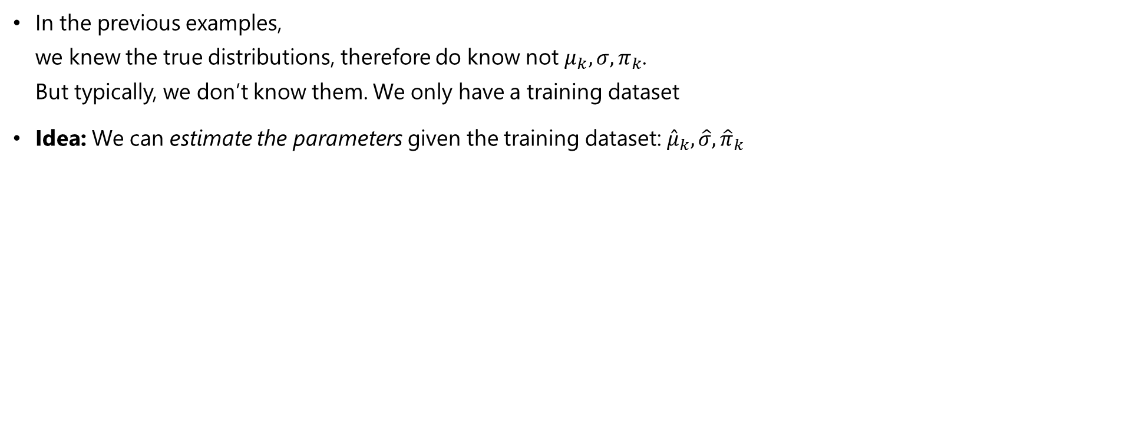
Discriminant Analysis - LDA
In real life, we often don’t know $μ_{k},σ,π_{k}$
In the previous examples, we knew the true distributions, therefore do know not $μ_{k},σ,π_{k}$. But typically, we don’t know them. We only have a training dataset
Idea: We can estimate the parameters given the training dataset: ${\hat{μ}}_{k},\hat{σ},{\hat{π}}_{k}$

Slide 18
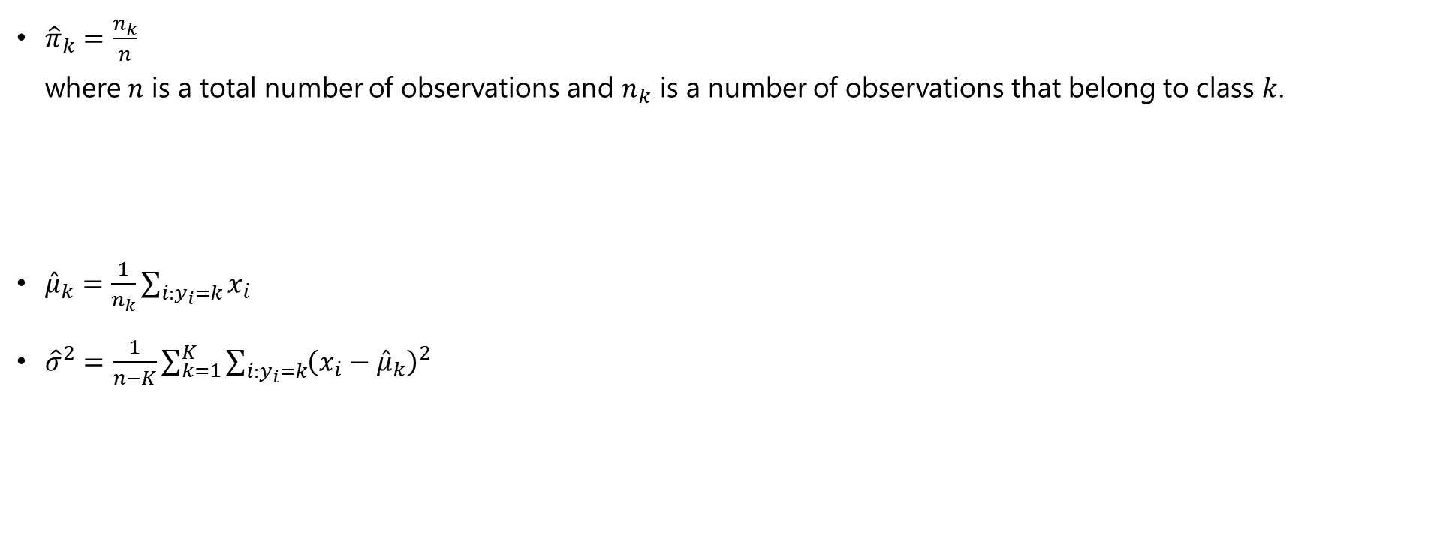
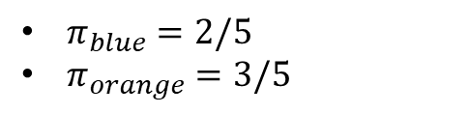
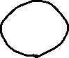
Discriminant Analysis - LDA
Estimation of the Parameters ${\hat{μ}}_{k},\hat{σ},{\hat{π}}_{k}$
${\hat{π}}_{k}=\frac{n_{k}}{n}$ where $n$ is a total number of observations and $n_{k}$ is a number of observations that belong to class $k$.
${\hat{μ}}_{k}=\frac{1}{n_{k}}\sum_{i:y_{i}=k}{x_{i}}$
${\hat{σ}}^{2}=\frac{1}{n−K}\sum_{k=1}^{K}{\sum_{i:y_{i}=k}^{ }{{\left(x_{i}−{\hat{μ}}_{k}\right)}^{2}}}$
$π_{blue}=2/5$
$π_{orange}=3/5$

Slide 19
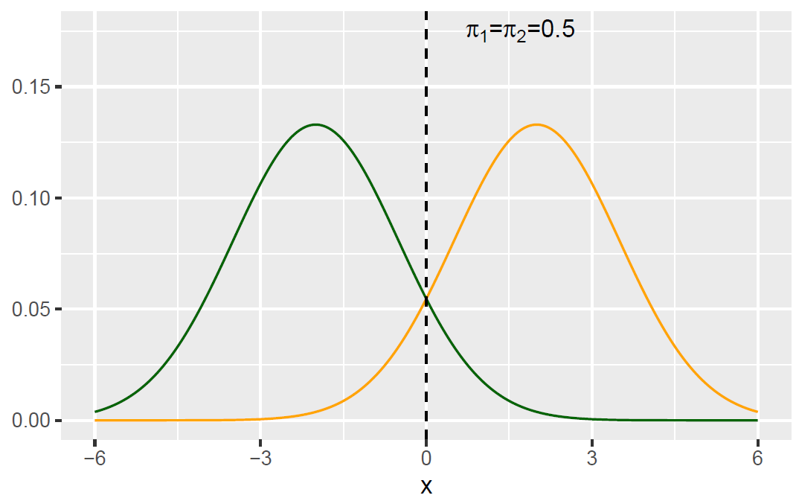
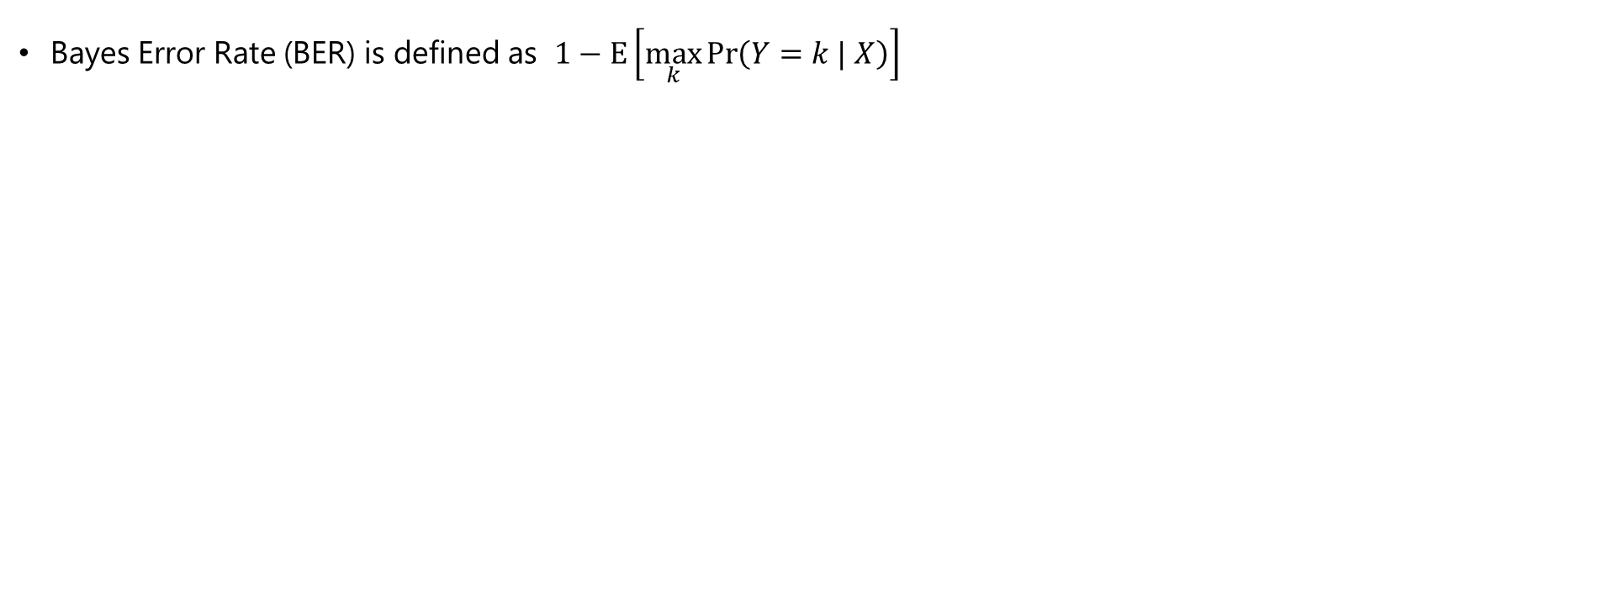



Discriminant Analysis - LDA
Performance Assessment: Bayes Error Rate (BER)
Bayes Error Rate (BER) is defined as $1−E\left[\max_{k}{\operatorname{Pr}\left(Y=k | X\right)}\right]$
$$\left\{\begin{aligned}p\left(Y=green | X=x\right)=0.7 \\ p\left(Y=yellow| X=x\right)=0.3\end{aligned}\right.$$
Then, $\max_{k}{\operatorname{Pr}\left(Y=k | X\right)}=0.7$
Therefore, BER is $1−0.7=0.3$

Slide 20


Discriminant Analysis - LDA
Performance Assessment: Bayes Error Rate (BER)
Bayes Error Rate (BER) is defined as $1−E\left[\max_{k}{\operatorname{Pr}\left(Y=k | X\right)}\right]$
We do this for all $x$ since we have expectation $E$.
$$\left\{\begin{aligned}p\left(Y=green | X=x\right)=1.0 \\ p\left(Y=yellow| X=x\right)=0.0\end{aligned}\right.$$
Then, $\max_{k}{\operatorname{Pr}\left(Y=k | X\right)}=1.0$. Therefore, BER is $1−1.0=0.$

Slide 21
Multivariate LDA

Slide 22



Multivariate LDA
LDA
Multivariate LDA
$\operatorname{Pr}\left(Y=k | X=x\right)$ $$=p_{k}(x)=\frac{f_{k}\left(x\right)π_{k}}{\sum_{l=1}^{K}{f_{l}\left(x\right)}π_{l}}=\frac{\frac{1}{\sqrt{2π}σ}e^{−\frac{1}{2}{\left(\frac{x−μ_{k}}{σ}\right)}^{2}}π_{k}}{\sum_{l=1}^{K}{\frac{1}{\sqrt{2π}σ}e^{−\frac{1}{2}{\left(\frac{x−μ_{l}}{σ}\right)}^{2}}}π_{l}}$$
$$\log\left(p_{k}(x)\right)∝δ_{k}\left(x\right)=\frac{xμ_{k}}{σ^{2}}−\frac{μ_{k}^{2}}{{2σ}^{2}}+\log\left(π_{k}\right)$$
Replace the univariate normal distribution with the multivariate normal distribution:
$$f\left(x\right)=\frac{1}{{\left(2π\right)}^{p/2}{\left|Σ\right|}^{1/2}}\exp\left(−\frac{1}{2}{\left(x−μ\right)}^{T}Σ^{−1}\left(x−μ\right)\right)$$
Then, we get
$δ_{k}\left(x\right)=xΣ^{−1}μ_{k}−\frac{1}{2}μ_{k}^{T}$ $Σ^{−1}μ_{k}+\log\left(π_{k}\right)$

Slide 23





Multivariate LDA
Discriminant score
$δ_{k}\left(x\right)=xΣ^{−1}μ_{k}−\frac{1}{2}μ_{k}^{T}$ $Σ^{−1}μ_{k}+\log\left(π_{k}\right)$
Example
We now have two normal distributions in 2-dimensional space
$x_{red}\sim N\left({\left(1,1\right)}^{T},\left(\begin{matrix}2 & 0 \\ 0 & 2\end{matrix}\right)\right)$ $x_{blue}\sim N\left({\left(3,3\right)}^{T},\left(\begin{matrix}2 & 0 \\ 0 & 2\end{matrix}\right)\right)$
We can analytically find the boundary line by solving
$$δ_{red}\left(x\right)=δ_{blue}\left(x\right)$$
$xΣ^{−1}μ_{red}−\frac{1}{2}μ_{red}^{T}$ $Σ^{−1}μ_{red}+\log\left(π_{red}\right)=xΣ^{−1}μ_{blue}−\frac{1}{2}μ_{blue}^{T} Σ^{−1}μ_{blue}+\log\left(π_{blue}\right)$
Then, it gives
$$x_{2}=4−x_{1}$$
$$x_{2}$$
$$x_{1}$$

Slide 24


Multivariate LDA
Discriminant score
$δ_{k}\left(x\right)=xΣ^{−1}μ_{k}−\frac{1}{2}μ_{k}^{T}$ $Σ^{−1}μ_{k}+\log\left(π_{k}\right)$
Example
We now have two normal distributions in 2-dimensional space
$x_{red}\sim N\left({\left(1,1\right)}^{T},\left(\begin{matrix}2 & 0 \\ 0 & 2\end{matrix}\right)\right)$ $x_{blue}\sim N\left({\left(3,3\right)}^{T},\left(\begin{matrix}2 & 0 \\ 0 & 2\end{matrix}\right)\right)$
In real life, we do not know the true distribution.
We just have a training set.
$$x_{2}$$
$$x_{2}$$
$$x_{1}$$
$$x_{1}$$

Slide 25

Multivariate LDA
Parameter Estimation & Classification with Multivariate LDA
In real life, we do not know the true distribution. We just have a training set.
To make the classification prediction, we first estimate ${\hat{μ}}_{k},\hat{Σ},{\hat{π}}_{k}$
$${\hat{μ}}_{k}=\frac{1}{n_{k}}\sum_{i:y_{i}=k}{X_{i}}$$
$$\hat{Σ}=\frac{1}{n−K}\sum_{k=1}^{K}{\sum_{i:y_{i}=k}{\left(X_{i}−{\hat{μ}}_{k}\right){\left(X_{i}−{\hat{μ}}_{k}\right)}^{T}}}$$
$${\hat{π}}_{k}=\frac{n_{k}}{n}$$ where $n$ is a total number of observations and $n_{k}$ is a number of observations that belong to class $k$.
Then, we can compute the discriminative score $δ_{k}\left(x\right)=xΣ^{−1}μ_{k}−\frac{1}{2}μ_{k}^{T}$ $Σ^{−1}μ_{k}+\log\left(π_{k}\right)$
And the classification is performed by ${argmax}_{k}δ_{k}\left(x\right)$

Slide 26




Multivariate LDA
LDA in R
Estimated decision boundary
Confusion matrix
(important performance metric)
General confusion matrix forms:

Slide 27
Quadratic Discriminant Analysis (QDA)

Slide 28





Quadratic Discriminant Analysis (QDA)
In LDA, we assumed that $Σ_{k}=Σ$ for all classes (modeling assumption).
In QDA, we allow different covariance matrices $Σ_{k}$ for each class.
Multivariate LDA
Multivariate QDA
$$x_{2}$$
$$x_{2}$$
The decision boundary is quadratic!
$$x_{1}$$
$$x_{1}$$

Slide 29

Quadratic Discriminant Analysis (QDA)
In LDA, we assumed that $Σ_{k}=Σ$ for all classes.
In QDA, we allow different covariance matrices $Σ_{k}$ for each class.
Multivariate LDA
Multivariate QDA

Slide 30


Multivariate LDA
Univariate LDA
Univariate QDA
$\operatorname{Pr}\left(Y=k | X=x\right)$ $$=p_{k}(x)=\frac{f_{k}\left(x\right)π_{k}}{\sum_{l=1}^{K}{f_{l}\left(x\right)}π_{l}}=\frac{\frac{1}{\sqrt{2π}σ}e^{−\frac{1}{2}{\left(\frac{x−μ_{k}}{σ}\right)}^{2}}π_{k}}{\sum_{l=1}^{K}{\frac{1}{\sqrt{2π}σ}e^{−\frac{1}{2}{\left(\frac{x−μ_{l}}{σ}\right)}^{2}}}π_{l}}$$
$$\log\left(p_{k}(x)\right)∝δ_{k}\left(x\right)=\frac{xμ_{k}}{σ^{2}}−\frac{μ_{k}^{2}}{{2σ}^{2}}+\log\left(π_{k}\right)$$
$\operatorname{Pr}\left(Y=k | X=x\right)$ $$=p_{k}(x)=\frac{f_{k}\left(x\right)π_{k}}{\sum_{l=1}^{K}{f_{l}\left(x\right)}π_{l}}=\frac{\frac{1}{\sqrt{2π}σ_{k}}e^{−\frac{1}{2}{\left(\frac{x−μ_{k}}{σ_{k}}\right)}^{2}}π_{k}}{\sum_{l=1}^{K}{\frac{1}{\sqrt{2π}σ_{l}}e^{−\frac{1}{2}{\left(\frac{x−μ_{l}}{σ_{l}}\right)}^{2}}}π_{l}}$$
$$\log\left(p_{k}(x)\right)∝δ_{k}\left(x\right)=\frac{xμ_{k}}{σ_{k}^{2}}−\frac{μ_{k}^{2}}{{2σ}_{k}^{2}}+\log\left(π_{k}\right)$$

Slide 31

Quadratic Discriminant Analysis (QDA)
Multivariate QDA
$\operatorname{Pr}\left(Y=k | X=x\right)=p_{k}\left(x\right)=\frac{f_{k}\left(x\right)π_{k}}{\sum_{l=1}^{K}{f_{l}\left(x\right)}π_{l}}$ where $f_{k}\left(x\right)=\frac{1}{{\left(2π\right)}^{p/2}{\left|Σ_{k}\right|}^{1/2}}\exp\left(−\frac{1}{2}{\left(x−μ_{k}\right)}^{T}{Σ_{k}}^{−1}\left(x−μ_{k}\right)\right)$
$δ_{k}\left(x\right)=−\frac{1}{2}{\left(x−μ_{k}\right)}^{T}{Σ_{k}}^{−1}\left(x−μ_{k}\right)−\frac{1}{2}\log\left|Σ_{k}\right|+\log{π_{k}}$ $=−\frac{1}{2}x^{T}{Σ_{k}}^{−1}x+x^{T}{Σ_{k}}^{−1}μ_{k}−\frac{1}{2}μ_{k}^{T}$ ${Σ_{k}}^{−1}μ_{k}−\frac{1}{2}\log\left|Σ_{k}\right|+\log{π_{k}}$

Slide 32


Quadratic Discriminant Analysis (QDA)
LDA vs QDA
QDA is more flexible than LDA, as it allows for class-specific covariance matrices $Σ_{k}$.
Should we always prefer QDA to LDA?
High Bias
Low Variance
Low Bias
High Variance

Slide 33





Quadratic Discriminant Analysis (QDA)
LDA vs QDA
QDA is more flexible than LDA, as it allows for class-specific covariance matrices $Σ_{k}$.
Should we always prefer QDA to LDA?
True decision boundary
(by the analytical solution)
LDA decision boundary
QDA decision boundary

Slide 34
Example w/ LDA, QDA

Slide 35

Example w/ LDA, QDA
Iris dataset

Slide 36

Example w/ LDA, QDA

Slide 37

Example w/ LDA, QDA

Slide 38


Example w/ LDA, QDA

Slide 39


Example w/ LDA, QDA

Slide 40


Example w/ LDA, QDA
Compare LDA and QDA by their prediction accuracies
Let’s create $X_{train}$ and $X_{test}$
Fit LDA and QDA on $X_{train}$

Slide 41




Example w/ LDA, QDA
Test LDA and QDA on $X_{test}$

Slide 42
Summary of Classification Methods

Slide 43

Summary of Classification Methods
Diagnostic Paradigm: directly estimate $\operatorname{Pr}\left(Y=k | X=x\right)$
Logistic regression
KNN (K Nearest Neighbors)
Sampling Paradigm: indirectly estimate $\operatorname{Pr}\left(Y=k | X=x\right)$ using Bayes Theorem
Naïve Bayes
Linear Discriminant Analysis (LDA)
Quadratic Discriminant Analysis (QDA)

Slide 44
Which classification method is the best?

Slide 45

Which classification method is the best?
Advantages of Discriminant Analysis
Linear Discriminant Analysis (LDA) is more stable than logistic regression when the classes are well-separated.
Moreover, LDA is more popular for multi-class classification. (Logistic regression is essentially for binary classification)
LDA’s decision boundary

Slide 46

Which classification method is the best?
Linearity Property
Assume a binary classification problem with one covariate
Recall that logistic regression can be written:
$$\log\left(\frac{p\left(x\right)}{1−p\left(x\right)}\right)=β_{0}+β_{1}x$$
For a two-class problem, one can show that for LDA: $\log\left(\frac{p_{1}\left(x\right)}{1−p_{1}\left(x\right)}\right)=\log\left(\frac{p_{1}\left(x\right)}{p_{2}\left(x\right)}\right)=…=β_{0}+β_{1}x$ thus the same linear form. The difference is in how the parameters are estimated.

Slide 47

Which classification method is the best?
LDA vs Logistic regression
In practice, the results are often very similar, but
LDA is more “more available” in the multi-class setting.
if the class conditional distributions are multivariate normal, then LDA (or QDA) is preferred.
Logistic regression makes no assumptions about the covariates and is therefore to be preferred in many practical applications.
In medicine, for two-class problems, logistic regression is often preferred (for interpretability) and (always) together with ROC and AUC (for model comparison).
and KNN?
KNN is used when the class boundaries are non-linear.
Yet, remember the curse of dimensionality (when $p$ is large)!

Slide 48

Which classification method is the best?
The answer is “It depends!”
Logistic regression is very popular for binary classification.
LDA is useful when $n$ is small, or the classes are well separated, and Gaussian assumptions are reasonable. Also when $K>2$.
Naïve Bayes is useful when $p$ is very large.
KNN is non-parametric, thus no assumptions about the decision boundary nor the distribution of the variables. Expected to work better than LDA and logistic regression when boundary is very non-linear.
Caveats: 1) no interpretation of the effect of the covariates is possible. 2) curse of dimensionality.
Please read Section 4.5 of the coursebook (James et al. 2013)

Slide 49
Two-class problems: Sensitivity, Specificity

Slide 50

Two-class problems: Sensitivity, Specificity
True Positive Rate
True Negative Rate

Slide 51


Two-class problems: Sensitivity, Specificity
Example
Test error = $\frac{20+5}{45+20+5+30}=0.25$
Sensitivity (True Positive Rate) = $\frac{45}{45+20}$
Specificity (True Negative Rate) = $\frac{30}{5+30}$

Slide 52

Two-class problems: Sensitivity, Specificity
ROC curve & AUC
N
P
Sensitivity
1-Specificity
= 1 - TrueNegativeRate

Slide 53

Two-class problems: Sensitivity, Specificity
ROC curve & AUC
Sensitivity
1-Specificity
= 1 - TrueNegativeRate
1-Specificity

Slide 54

Two-class problems: Sensitivity, Specificity
ROC curve and AUC
ROC (receiver operating characteristics) curve gives a graphical display of the sensitivity against (1-specificity), as the threshold value (decision boundary) is moved from 0 to 1.
An ideal classifier will give:
The AUC ranges between 0 and 1.
0 denotes completely-wrong, 1 denotes completely-correct.
AUC is useful for comparing the performance of different classifiers.

Slide 55


Slide 56

The End!

